Slide 1
Final Engagement
Attack, Defense & Analysis of a Vulnerable Network
Arthur Kasozi, Aloysius Lloyd, Chris Allen, Clayton Smith, Mathew Wrona, Rex Budiwarman, Rolland Emeana, and Saif Patel

Slide 2
Table of Contents
This document contains the following resources:
Network Topology & Critical Vulnerabilities
Alerts Implemented
Hardening
Implementing Patches

Slide 3

Network Topology
& Critical Vulnerabilities
3

Slide 4
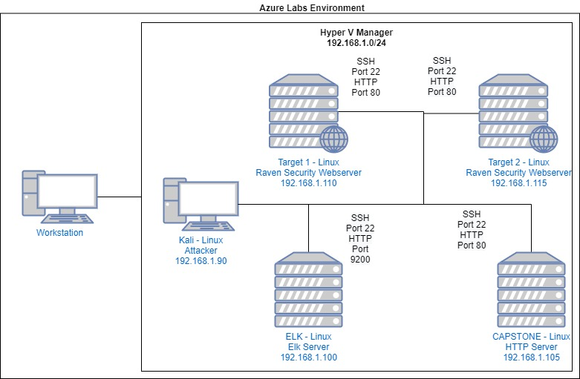
Network Topology
[Insert Here]
Use draw.io to create a diagram of the network.
Add your diagram to this slide and fill out the data in the sidebar.
Network
Address Range: 192.168.1.0-255
Netmask: /24
Gateway: 192.168.1.1
Machines
IPv4: 192.168.1.110
OS: Linux
Hostname: Target 1
IPv4: 192.168.1.110
OS: Linux
Hostname: Target 2
IPv4: 192.169.1.100
OS: Linux
Hostname: ELK
IPv4: 192.168.1.105
OS: Linux
Hostname: CAPSTONE

Slide 5
Critical Vulnerabilities: Target 1
Our assessment uncovered the following critical vulnerabilities in Target 1.
Vulnerability | Description | Impact
Wordpress User Enumeration | Utilized enum4linux to gather user information for the web server | Allows attacker to gather usernames to gain access to the web server
Weak Passwords | Was able to find passwords using dictionary brute force against web form | Allowed attacker to gain access to protected web directories
Weak Cryptographic Hash | Used Rainbow table to compare an unprotected hash to a corresponding password | Allowed attacker to gain access to WebDav to alter contents of web server
Privilege Escalation | Used Stevens sudo Python access to escalate from ‘Steven to root’ | Allowed privilege escalation to root

Slide 6
Alerts Implemented
6

Slide 7
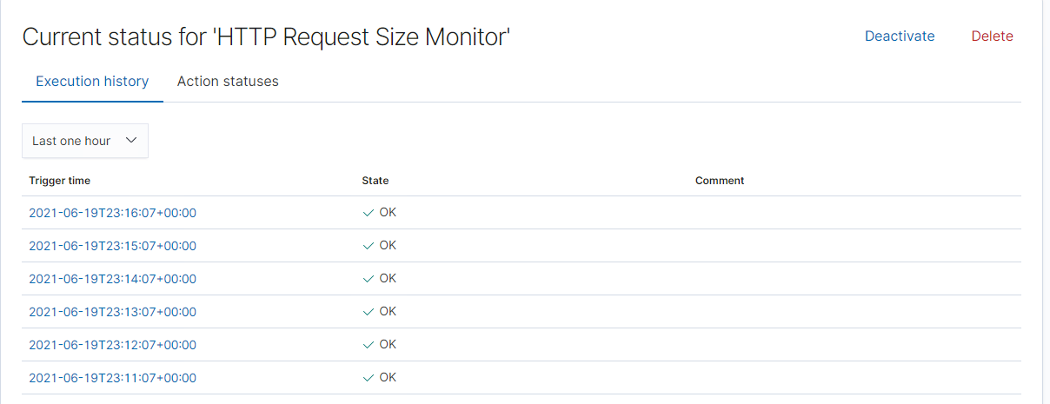
HTTP Request Size Monitor
The metric this alert monitors is the sum of http.request.bytes over all documents. The threshold it fires at is any value above 3500.

Slide 8
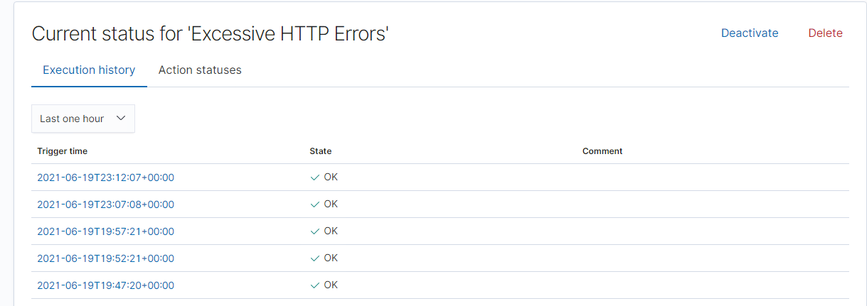
Excessive HTTP Errors
The metric this alert monitors is excessive http error responses. The alert counts the top 5 http.response.status_codes and fires when any value exceeds 400.

Slide 9
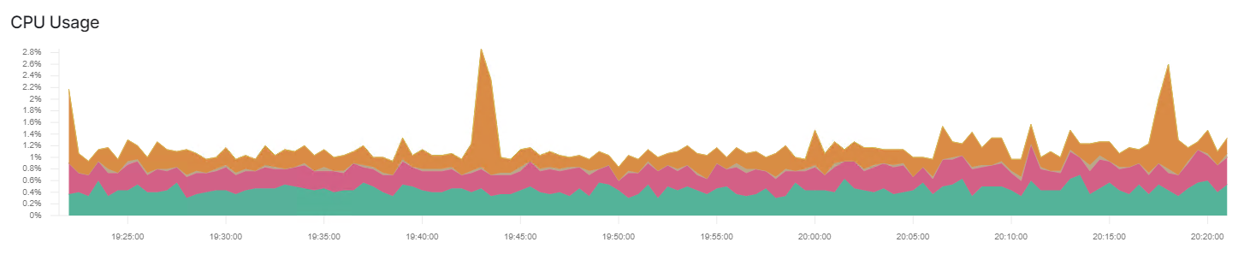
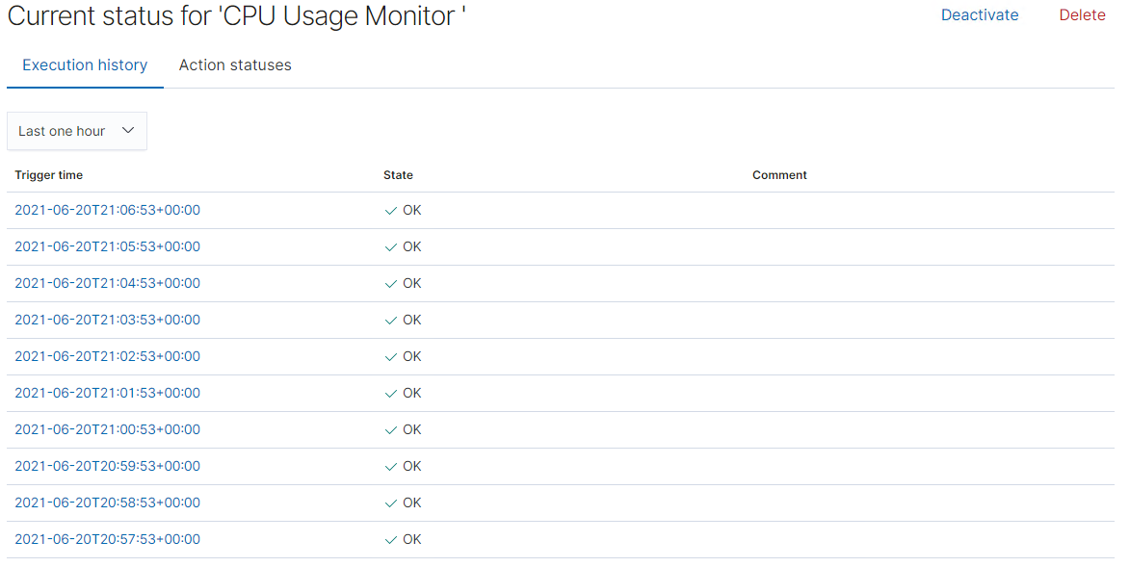
CPU Usage Monitor
The metric this alert monitors is max system.process.cpu.total.pct. It fires at a threshold of above 0.5% sustained over a period of 5 minutes.

Slide 10
Hardening
10

Slide 11
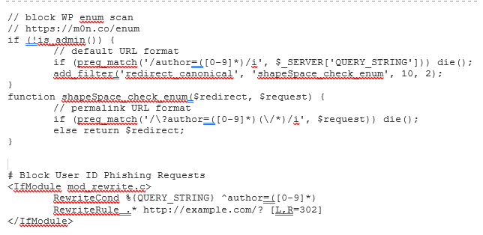
Hardening Against Enumeration in WordPress on Target 1
To stop user enumeration in WordPress, we must:
Disable the scans, which is done by adding a code snippet to the theme’s function.php file and (or) the site’s root.htaccess file.
We must also make sure the theme does not display login usernames by changing all user displays to anything other than the login name, make sure author/user template tags are not displayed and disable author/user archive entities if they are not needed.

Slide 12
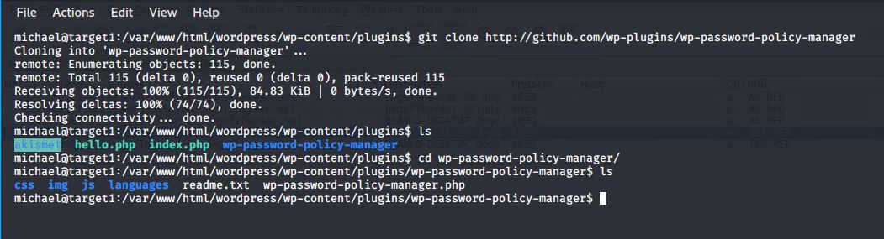
Hardening Against Dictionary Attacks on Target 1
We can use the command “git clone https://github.com/wp-plugins/wp-password-policy-manager” while inside the /wp-content/plugins/ directory to install a password manager.
This will allow for further customization of password policies including password length, case sensitivity, digit policy, character policy, password expiry time, etc. The key to slowing down dictionary attacks is to ensure user credentials are difficult to guess and this plugin will make it easier to govern what kinds of passwords can be created.

Slide 13
Hardening Against Weak Cryptographic Hash on Target 1
Wordpress by default uses Salted MD5 encryption.
Salted MD5 is easily crackable once the contents of ‘wp_users’ table are exposed.
To prevent this, the recommendation is to switch to a more robust encryption scheme such as bcrypt.
bcrypt is the most computationally expensive algorithm out of the three that wordpress natively supports.
To install the plugin wp-bcrypt.
Command to install:
git init
git pull https://github.com/roots/wp-password-bcrypt.git
cp wp-password-bcrypt.php var/www/html/wordpress/wp-content/mu-plugin
Notes:
Assuming that the web server itself may be compromised, we thought it best to add another layer of security. We are aware that unable to encrypt the wp-config.php file or remove the sensitive mysql information. Wordpress by default uses Salted MD5 encryption.
MD5, even salted is easily crackable once the contents of ‘wp_users’ table are exposed or dumped..
To prevent this, the recommendation is to switch to more robust encryption scheme such as bcrypt.
bcrypt is the most computationally expensive algorithm out of the three that wordpress natively supports. This means that it would take a long time to crack a hash.while It wont stop a bad actor from eventually cracking a password, it will make it so slow that it will not be worth
Installing the plugin is easily achieved by installing a wordpress plugin to the must use directory. The must use directory ensures that any potential bad actors cannot remove it easily.

Slide 14
Implementing Patches
14

Slide 15
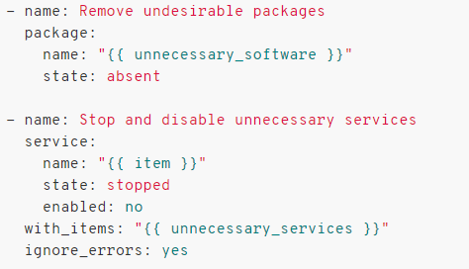
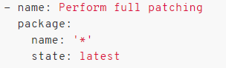
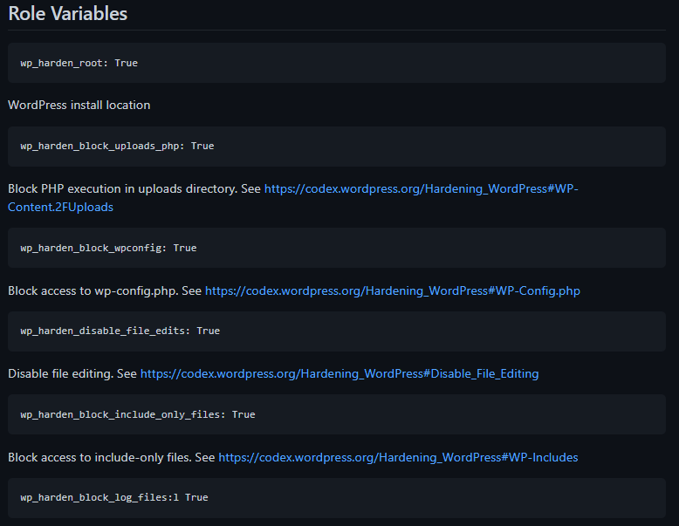
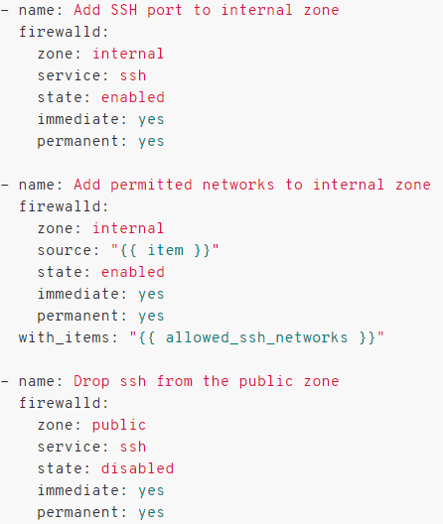
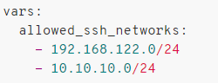
Implementing Patches with Ansible
Chron jobs will be utilized to regularly and automatically issue system wide updates.
3. Disable unused add-ons and unnecessary services:
2. Configure the SSH service to the internal zone and establish a list of allowed networks. Ansible makes this simple with the firewalld module. Here is an example:
4. Harden the existing wordpress installation and future installations through role variables on ansible:

